Slide 1
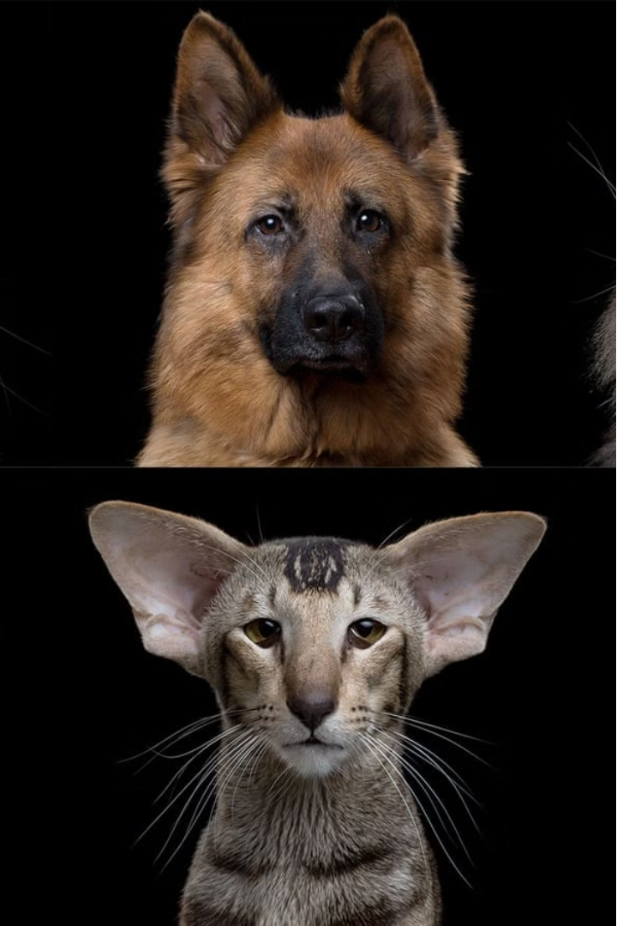



Introduction to Image Segmentation and Breed Classification
This presentation explores the exciting field of image segmentation and breed classification using the Oxford IIIT dataset. We will dive into the methodology, discuss the model architecture, and analyze the evaluation metrics and results. By the end, you'll have a comprehensive understanding of this state-of-the-art computer vision project.
by vasanth gopal

Slide 2
Overview of the Oxford IIIT Dataset
Dataset Details
Image Diversity
Annotation Quality
The Oxford IIIT dataset contains over 37,000 images of 200 dog breeds. It's a widely used benchmark for breed classification tasks in computer vision.
The dataset includes images of dogs in various poses, lighting conditions, and backgrounds, making it a challenging and realistic dataset for model training.
Each image is carefully annotated with bounding boxes and breed labels, providing high-quality ground truth data for supervised learning.

Slide 3
Problem Statement and Objectives
1
Image Segmentation
2
Breed Classification
3
Real-World Applications
Accurately identify and segment the dog within each image, separating the dog from the background.
Classify the dog breed with high accuracy, leveraging the rich visual features in the dataset.
Develop a robust system that can be deployed in practical applications like pet identification and retrieval.

Slide 4
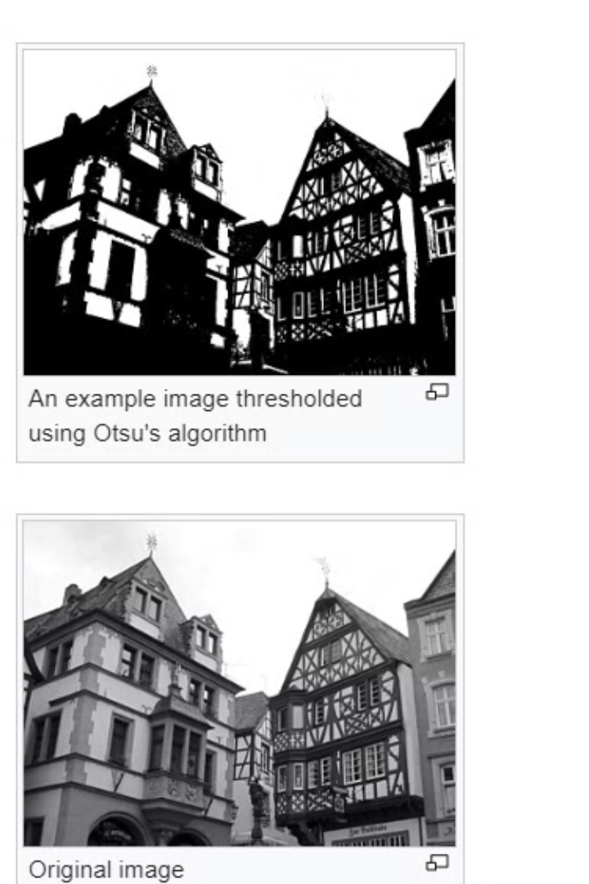
Otsu algorithm and Sobel Operator
Otsu's Method helps in segmenting objects from the background by determining an optimal threshold value for binarization.
Sobel Operator helps in segmenting objects by detecting edges, which are often used as features for segmentation algorithms.

Slide 5
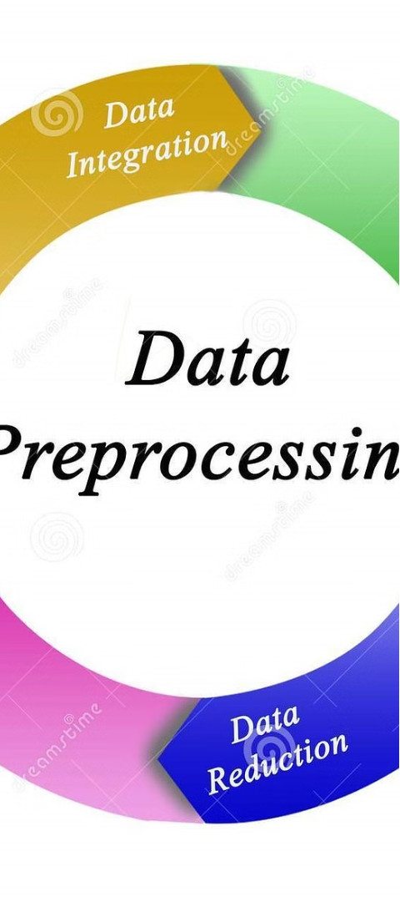
Methodology: Data Preprocessing and Augmentation
1
Data Preprocessing
Resize and normalize the images to a consistent format, handle missing or corrupted data, and encode the breed labels.
2
Data Augmentation
Apply techniques like rotation, flipping, scaling, and color jittering to increase the diversity of the training data and improve model generalization.
3
Train-Test Split
Divide the dataset into training, validation, and test sets to properly evaluate the model's performance and prevent overfitting.

Slide 6



Model Architecture and Training
Feature Extraction
Utilize a pre-trained convolutional neural network (CNN) to extract robust visual features from the input images.
Breed Classification
Feed the extracted features into a fully connected network to classify the dog breed with high accuracy.
Segmentation Mask
Employ a separate segmentation network to generate a pixel-wise mask of the dog within the image.

Slide 7
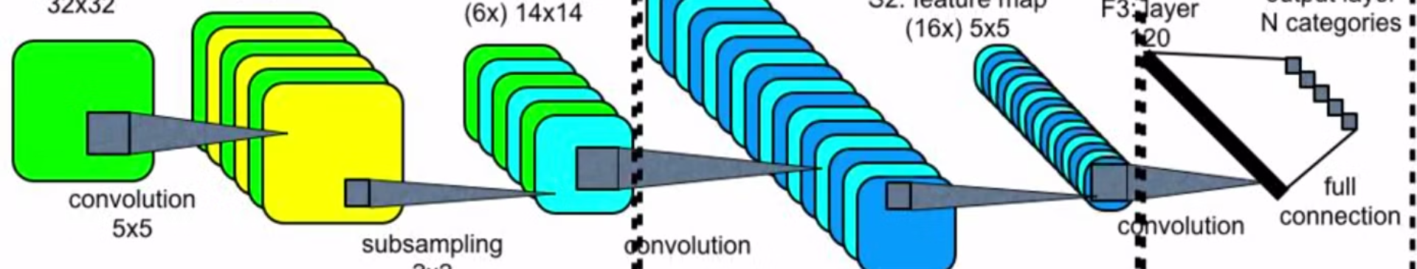
Convolution Neural Networks
Convolutional Neural Networks (CNNs) are a specialized type of neural network designed specifically for processing structured grid data, such as images. They are highly effective for tasks like image recognition, object detection, and image classification. CNNs are inspired by the organization of the animal visual cortex, where individual neurons respond to specific stimuli in a restricted region of the visual field.

Slide 8
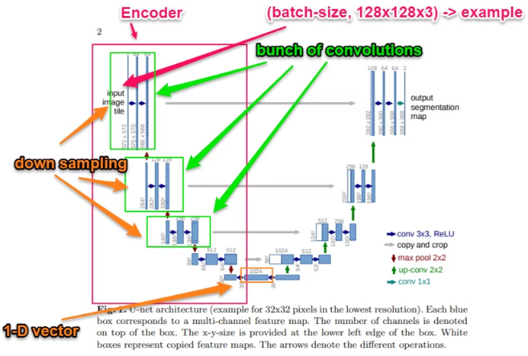
U-net Architecture
U-Net is a popular convolutional neural network architecture designed for semantic segmentation tasks, particularly in medical image analysis, where precise pixel-level segmentation is required. It was introduced by Olaf Ronneberger, Philipp Fischer, and Thomas Brox in their 2015 paper titled "U-Net: Convolutional Networks for Biomedical Image Segmentation."

Slide 9
MobileNetV2 and Pix2Pix
MobileNetV2 is a convolutional neural network architecture designed for efficient and lightweight deep learning models, particularly targeted for mobile and embedded devices. It is an evolution of the original MobileNet architecture, incorporating improvements to both the architecture and training methodology.
Pix2Pix is a type of conditional generative adversarial network (GAN) designed for image-to-image translation tasks. It was introduced by researchers at the University of California, Berkeley, in 2017. Pix2Pix is particularly powerful for tasks where an input image is transformed into an output image while preserving the semantic content of the input.
Using TensorFlow / Keras
MobileNetV2
Encoder
Pix2Pix
Decoder
Model Compilation
Loss Function
SparseCategoricalCrossEntropy

Slide 10



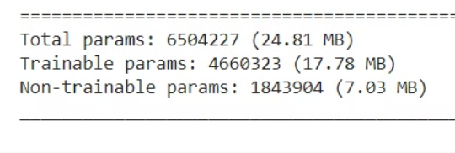
Evaluation Metrics and Results
Total Parameters
Segmentation
Epochs - 10
The image segmentation model was able effectively predict the segmentation mask separating the dog from the background
The model demonstrated high precision, correctly identifying 90.96% of the true dog breed instances.
.

Slide 11
Challenges and Limitations
Occlusion and Clutter
Breed Similarity
Handling images with partial dog visibility or complex backgrounds remains a challenge for the segmentation model.
Distinguishing between visually similar dog breeds can be difficult, requiring more advanced feature representations.
Dataset Bias
Real-Time Deployment
The dataset may not fully represent the diversity of dog breeds, leading to biases in the model's performance.
Deploying the model in real-world applications with strict latency requirements is an ongoing engineering challenge.

Slide 12

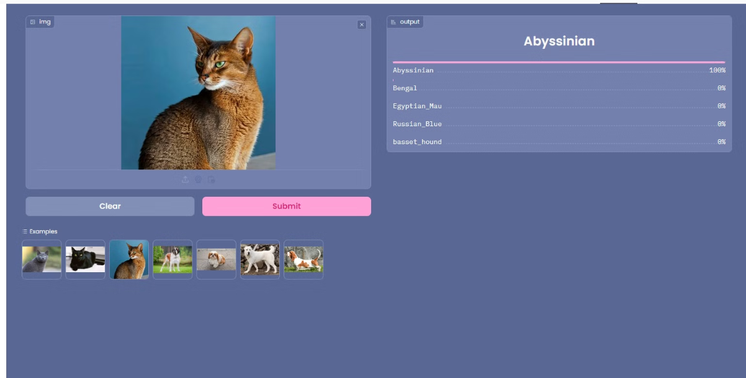
Model Deployment with Gradio and Huggingface / Spaces

Slide 13
Conclusion and Future Work
Key Takeaways
Future Directions
Real-World Impact
The presented system demonstrates the power of deep learning in tackling complex computer vision tasks, such as image segmentation and breed classification.
Explore more advanced architectures, incorporate additional data sources, and investigate transfer learning to further improve the model's performance and robustness.
The developed technology has the potential to enable a wide range of practical applications, from pet identification to wildlife monitoring and beyond.

